Slide 1
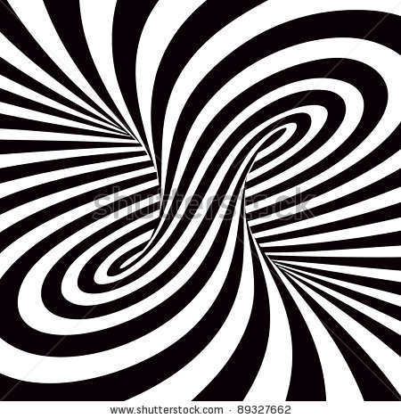
ILLUSIONS
Lesson 1: Characteristics of Science

Slide 2
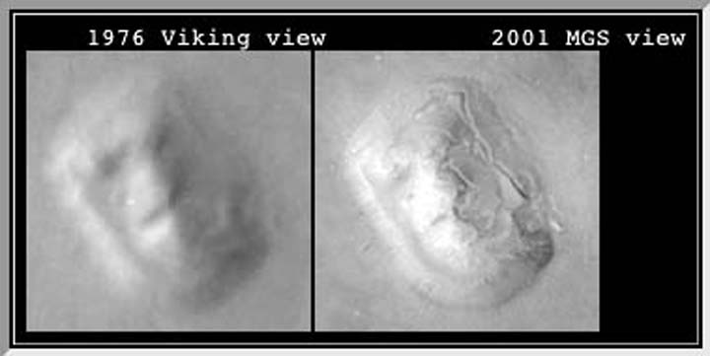
This is a picture taken of the surface of Mars.
What do you see?

Slide 3
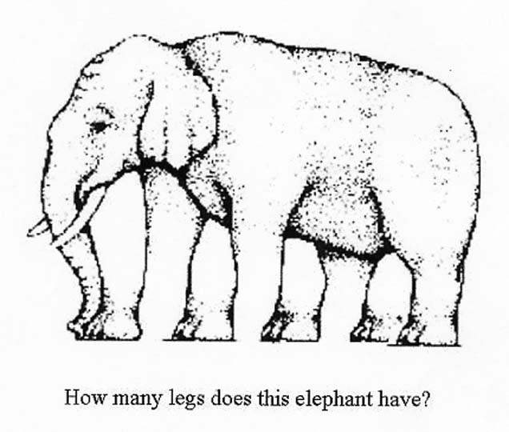

Slide 4
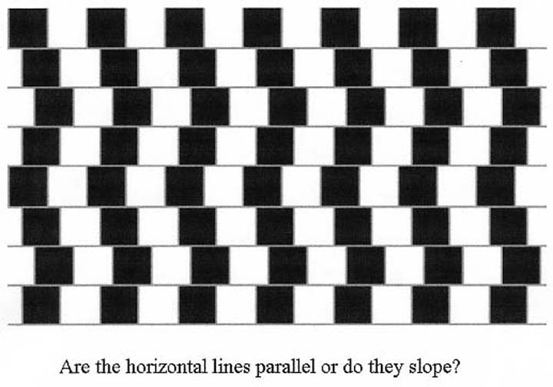
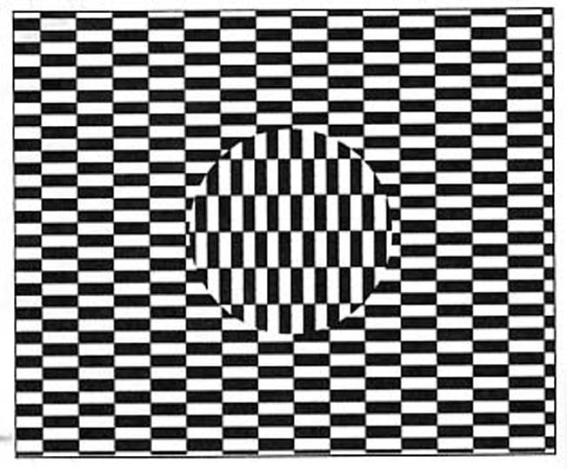
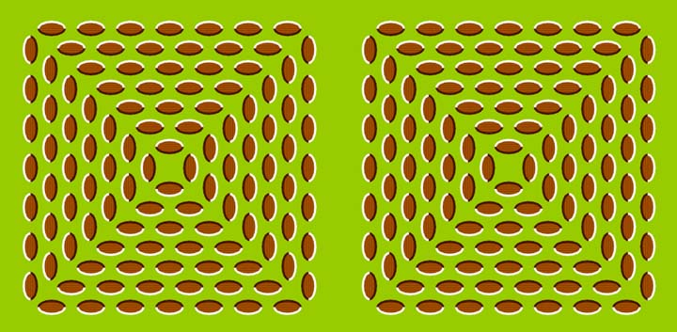

Slide 5
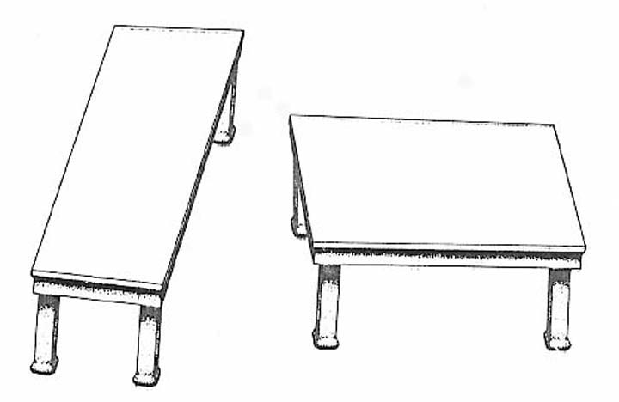
Which table is longer? Are you sure?

Slide 6
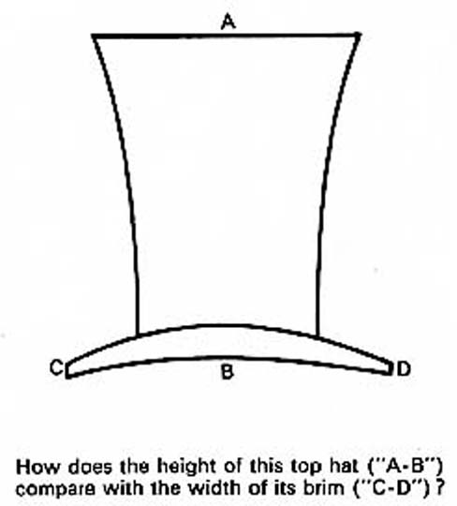

Slide 7
Why is this an illusion?
In pairs, cover the vertical line of the T and stop when you believe it is the same size as the horizontal line.

Slide 8
Natural Illusions – Past & present
In pairs, come up with as many natural illusions from the past and present – 5 minutes

Slide 9
Natural Illusions – Past & present
We are the center of the Universe
Stars are on the surface of a dome … our sky
Earth is closer to the Sun in summer
The Sun moves around the Earth
The Earth is not moving
The Earth is flat
Earthquakes
Lightening
Continental Drift
Rainbows
Eclipses
Mirages
Light travels instantaneously
Viruses
Species are fixed and unchanging
All matter is solid

